Slide 1

EXPOSYS DATA LABS
Presentation On Real-Time Chat Application Project
Title of Project: “Real-Time Chat Application”.
Presented By : Mr. Ajit Shamrao Patil

Slide 2
Contents :
Introduction
Problem Statement
Technology
Methodology
Implementation
Reference
Conclusion

Slide 3
Introduction :
In today's digital age, communication plays a vital role in connecting people from different parts of the world.
Our Real-Time Chat Application aims to provide a seamless and interactive platform for users to engage in instant messaging.
This application offers real-time communication capabilities, enabling users to exchange messages, share files, and collaborate efficiently.
Join us as we explore the features, technologies, and methodology behind our Real-Time Chat Application

Slide 4
Problem Statement :
“Implementation of Real-Time Chat Application with Nodejs and Mongodb”

Slide 5
Technology:
Software:
Front-end:
HTML
CSS
JavaScript
Backend:
Node.js
Hardware:
Windows : Windows 8 and above
RAM : Above 4 GB
Processor : Minimum Dual Core processor required.

Slide 6
Methodology :
Project Structure
Steps Involved in a Real-Time Chat Application
1.Requirement Analysis:
Conducted a thorough analysis of user requirements and expectations for the chat application.
Identified key features such as real-time messaging, file sharing, and user authentication.
2.Technology Selection:
Chose HTML, CSS, and JavaScript for the front-end development to create an engaging user interface.
Selected Node.js as the backend technology for its scalability, event-driven architecture, and real-time capabilities.
3.Architecture Design:
Designed a client-server architecture to facilitate seamless communication between users.

Slide 7
Methodology :
4.Database Integration:
Integrated a database system (e.g., MySQL, MongoDB) to store user information, chat logs, and other relevant data.
Ensured data security and privacy through proper encryption and access control measures.
5.User Interface Design:
Created an intuitive and user-friendly interface using HTML, CSS, and JavaScript.
6.Testing and Quality Assurance:
Conducted rigorous testing to identify and fix any bugs or issues in the application.
Ensured the application's performance, reliability, and security through comprehensive quality assurance measures.

Slide 8
Implementation :
1.Front-end Development:
Utilized HTML, CSS, and JavaScript to create an engaging and interactive user interface.
Designed a responsive layout to ensure optimal viewing across various devices.
2.Back-end Development:
Implemented the server-side functionality using Node.js, a powerful and scalable JavaScript runtime.
Integrated libraries and frameworks like Express.js to handle routing and HTTP requests.
3.Real-Time Communication:
Leveraged WebSocket technology to enable real-time messaging between users.

Slide 9
Implementation :
4.Database Integration:
Integrated a database system (e.g. MongoDB) to store user information and chat history.
Implemented database queries and transactions to retrieve and store data efficiently.
5.Deployment:
Deployed the chat application on a suitable hosting platform for accessibility.
Configured server environments and optimized application performance for production use.
6.User Authentication:
Implemented a secure authentication system to ensure only authorized users can access the chat application.
Utilized encryption techniques and industry best practices for password storage and user validation.

Slide 10
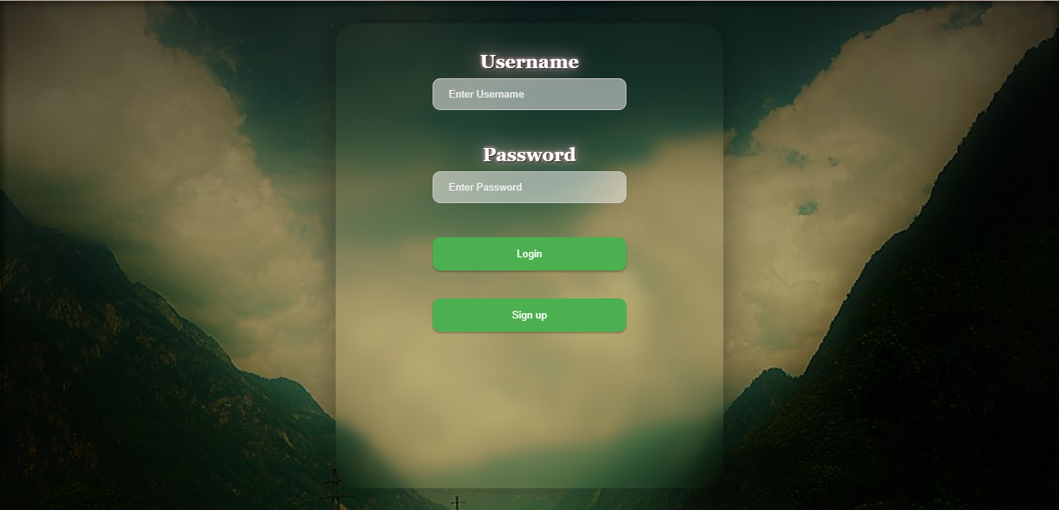
Implementation Screenshots:

Slide 11
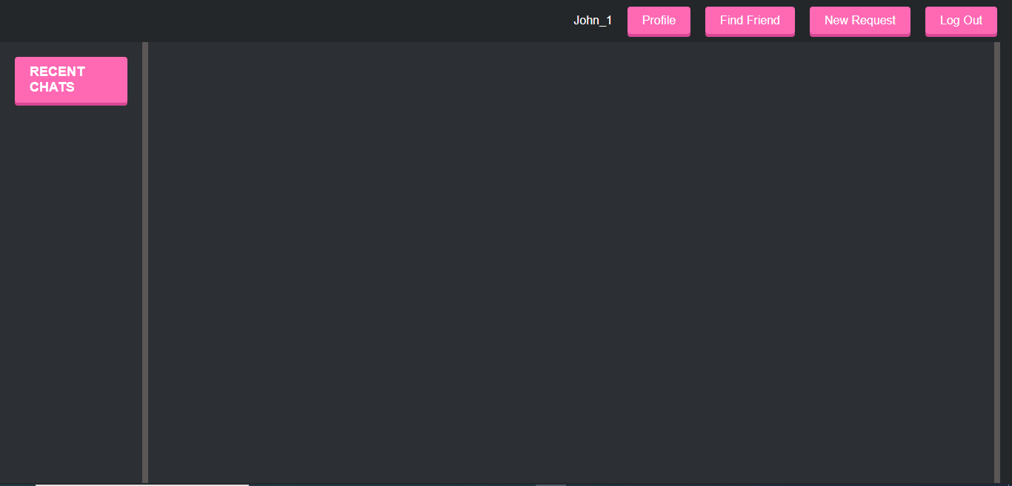
Implementation Screenshots:

Slide 12
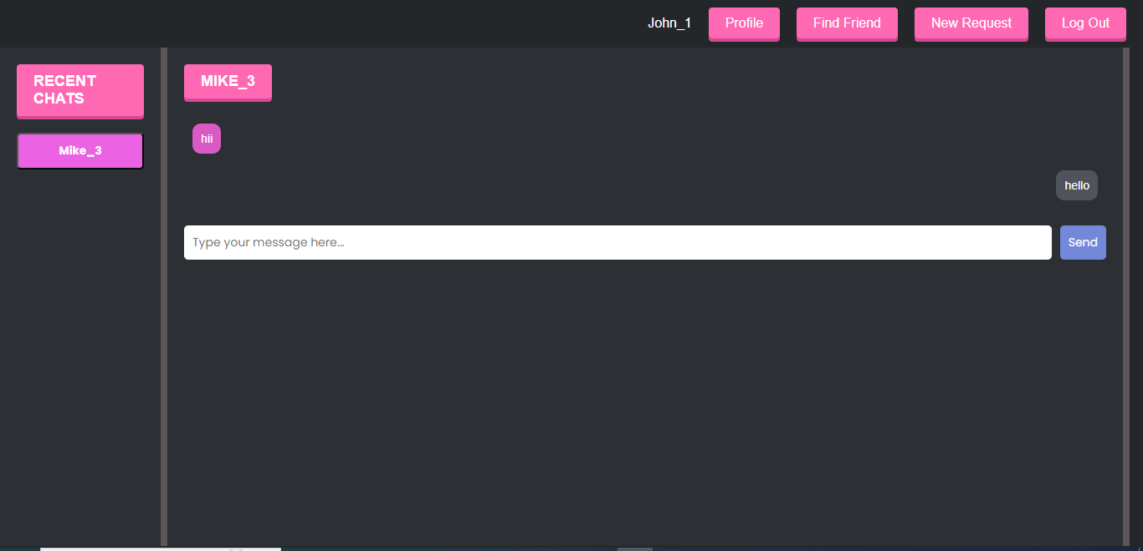
Implementation Screenshots:

Slide 13
Conclusion:
The successful completion of this Real-Time Chat Application project opens up possibilities for its application in various domains, including team collaboration, customer support, and community engagement.
The implementation phase involved thorough front-end and back-end development, ensuring an engaging user interface and a robust server-side functionality.

Slide 14
References:
[1] https://nodejs.org/en
[2] http://www.w3schools.com
[3] https://www.geeksforgeeks.org/
[4] https://stackoverflow.com/

Slide 15


